Slide 1
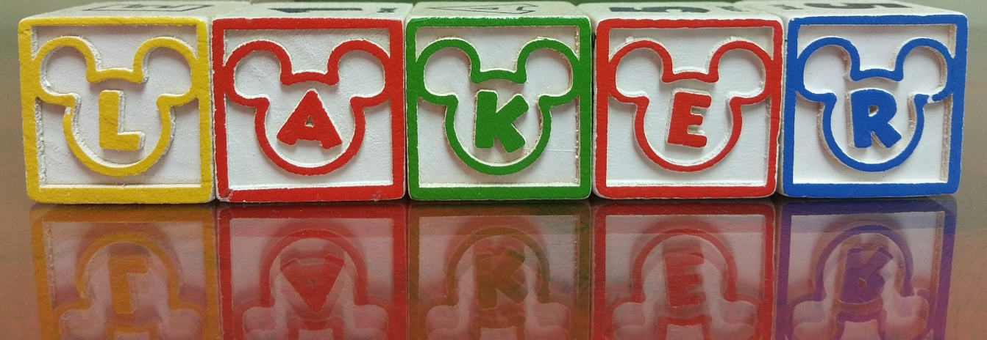
Camdenton R-III School District 2016-17 School Social Work Services by: Rebecca R. Caufield, LMSW, School Social Worker
It is a Great Day to be a

Slide 2
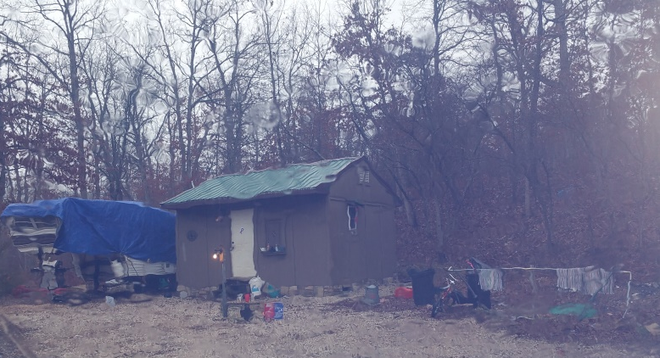
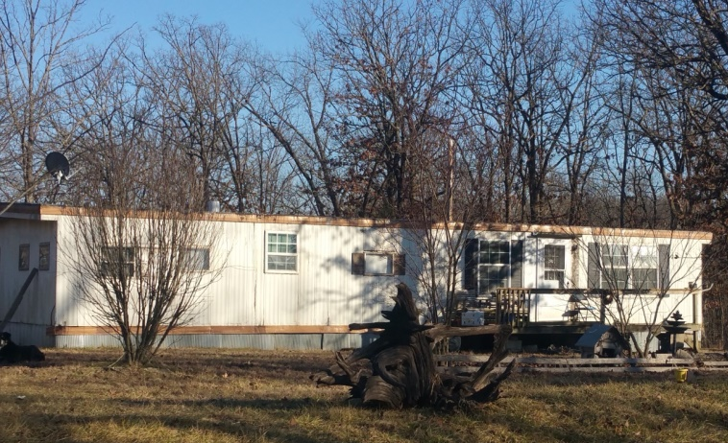
Some homes of students served:

Slide 3
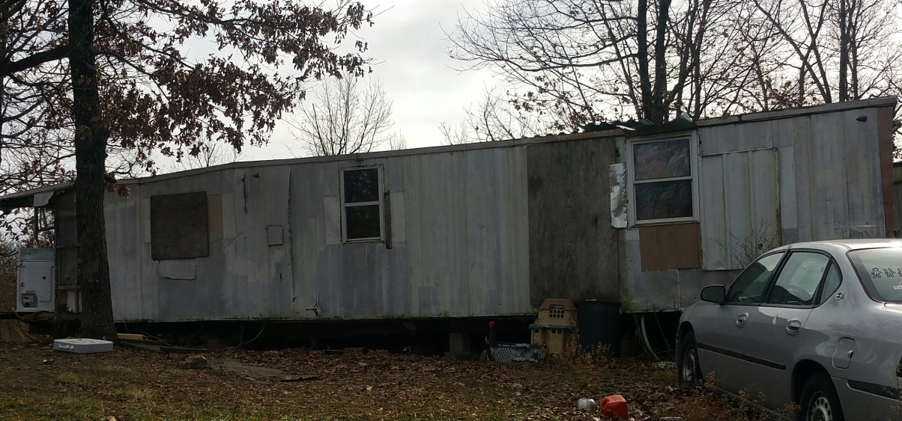
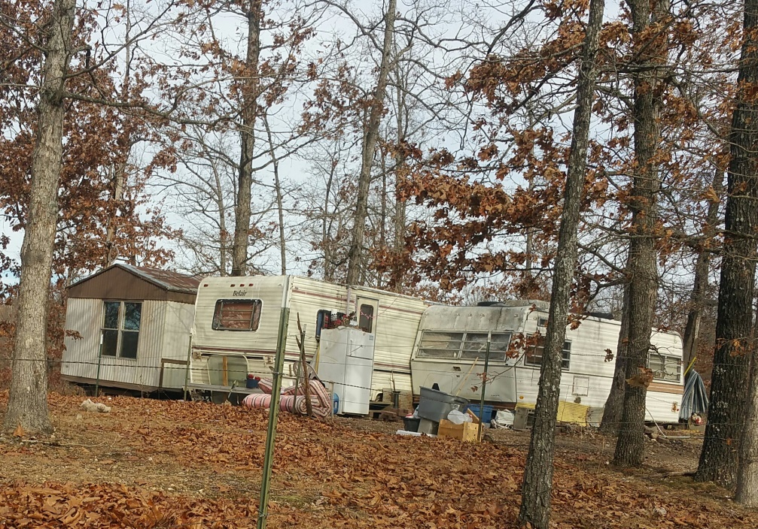
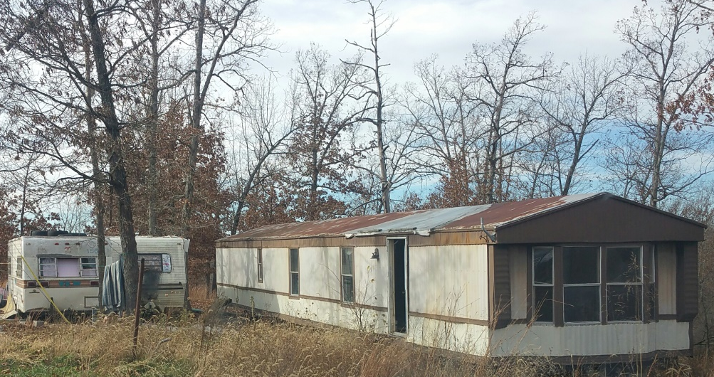
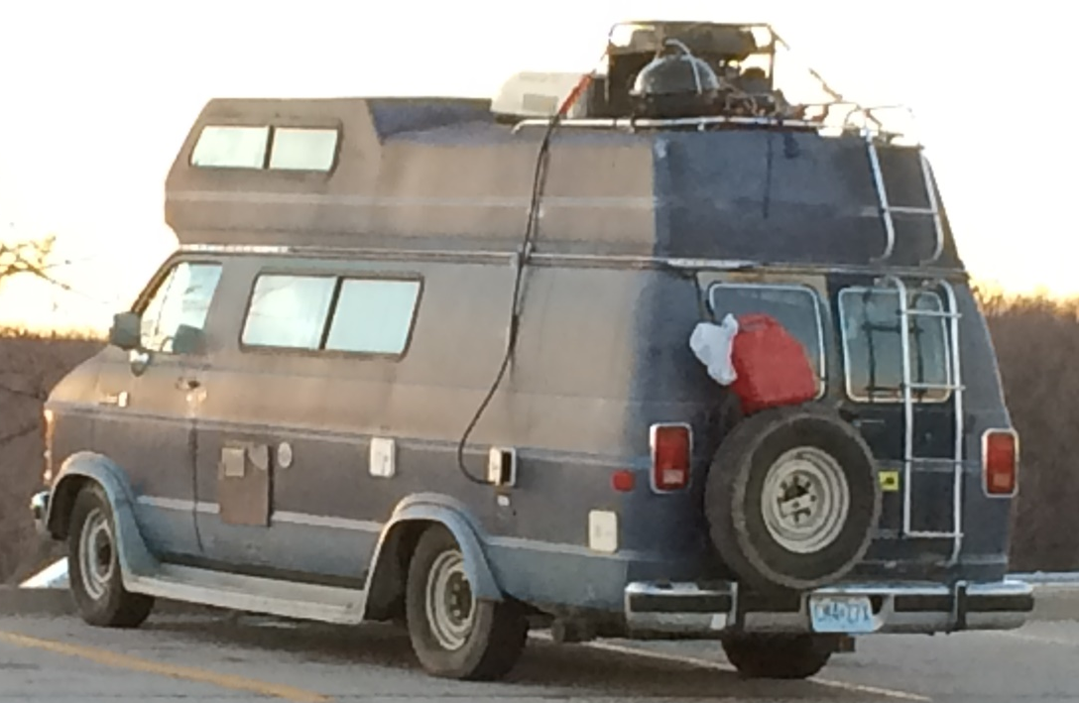

Slide 4
One of the first directives my supervisor, Dr. Dill gave me at the beginning of 2015/16 school year was: “Dogwood Elementary’s 90/90 is at 81%. HELP GET THAT TO OR ABOVE 90%!”

Slide 5
Dogwood Elementary 90/90:
2014/2015: 81.04%
2015/2016: 88.74%
2016/2017: 93.68%
Thanks DE Attd Action TEAM!!
You ROCK!

Slide 6
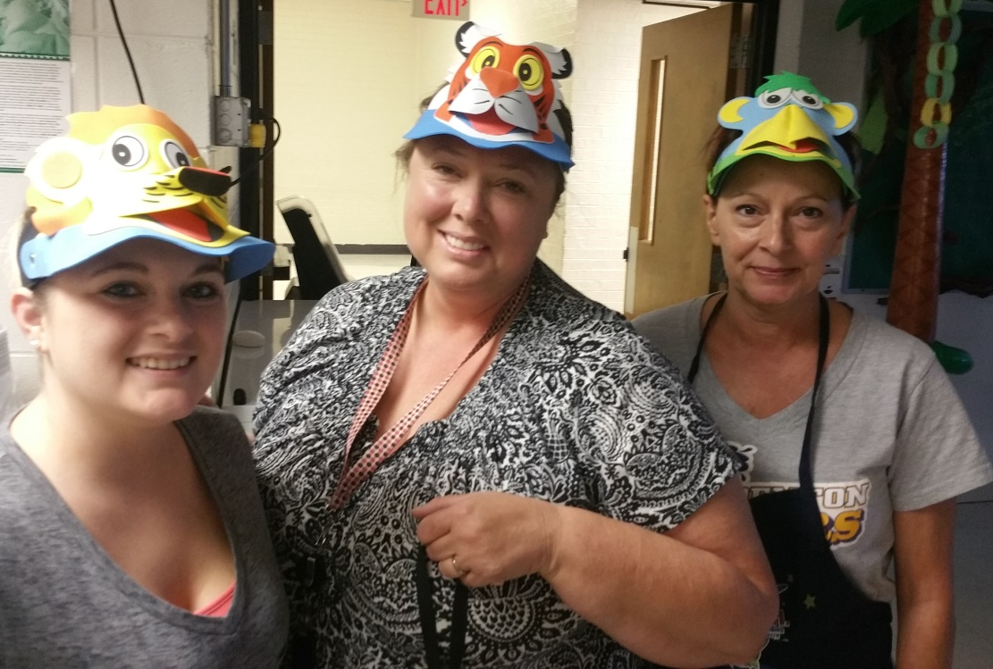
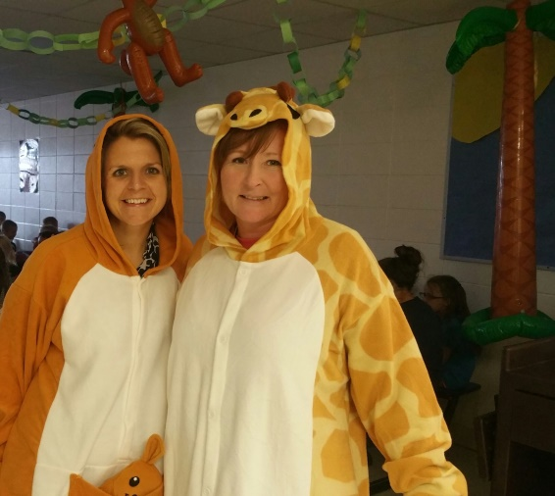
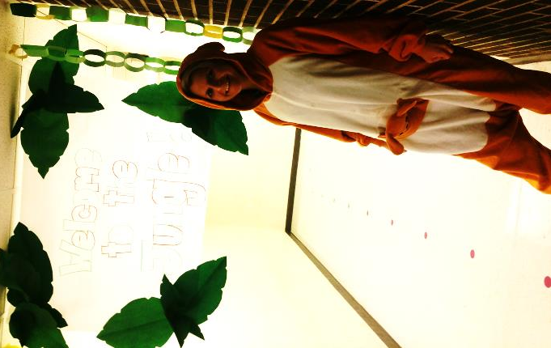
Dogwood Elementary Attendance Celebrations
100% September: Jungle

Slide 7
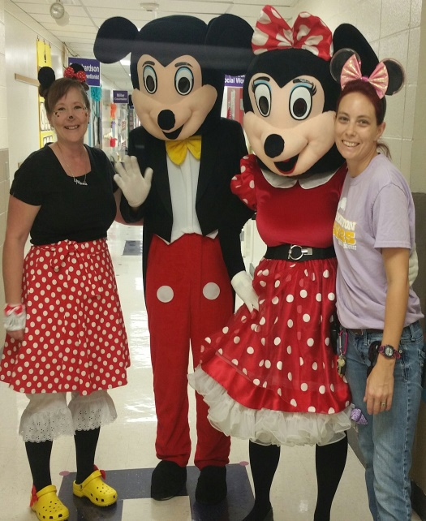
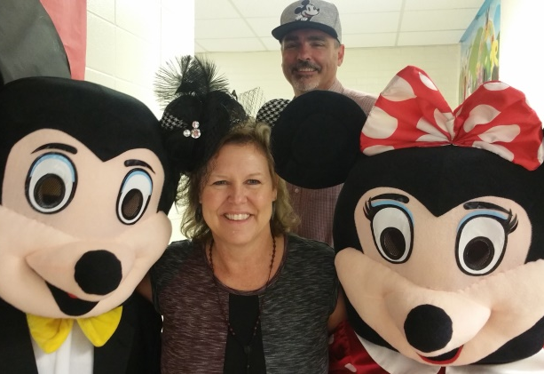
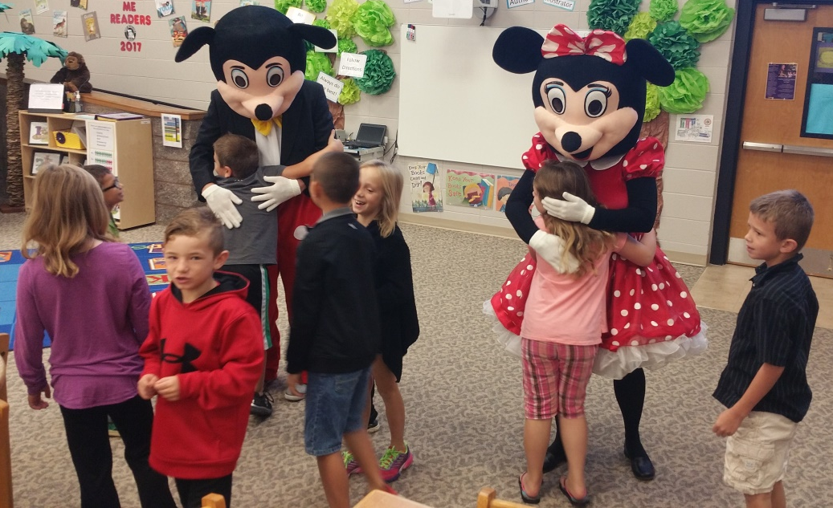
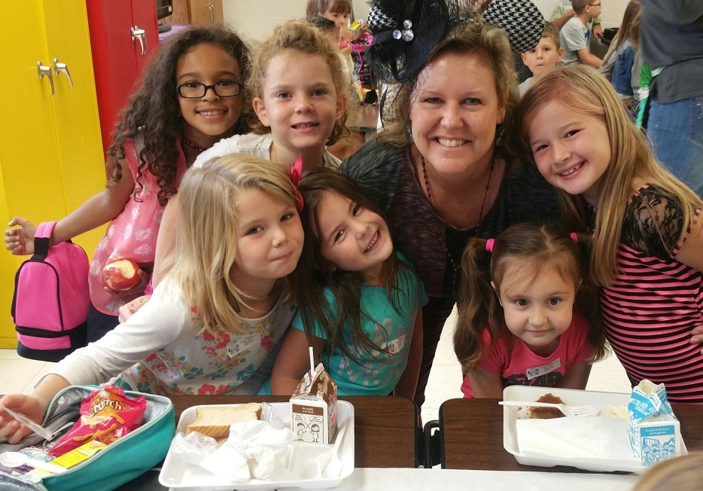
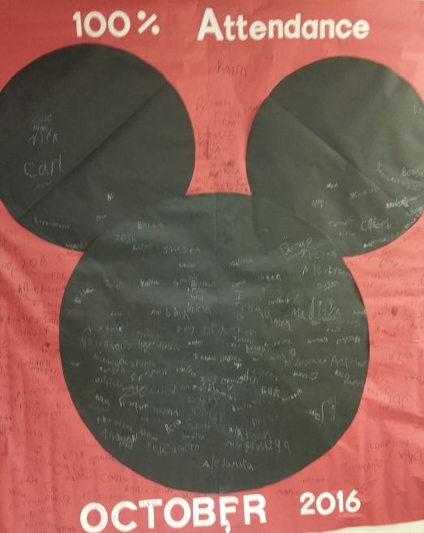
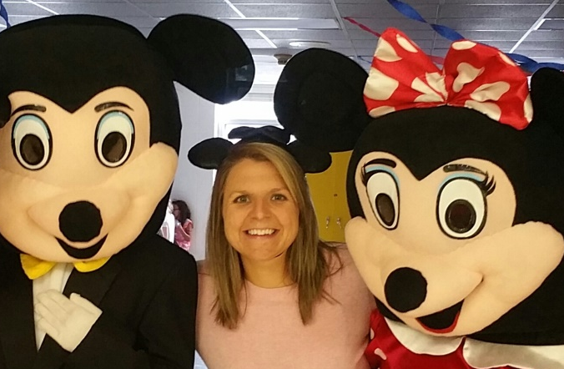
100% in October: Mickey and Minnie

Slide 8
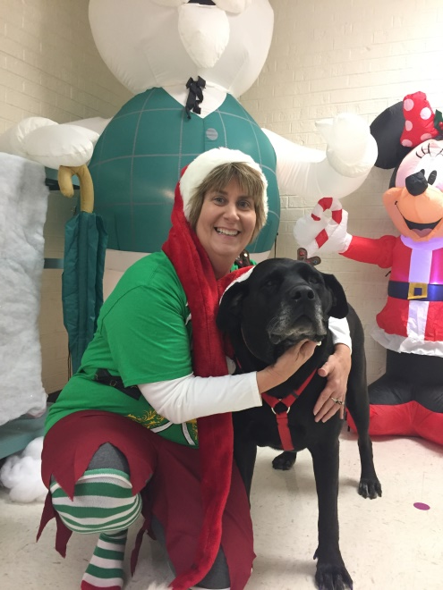
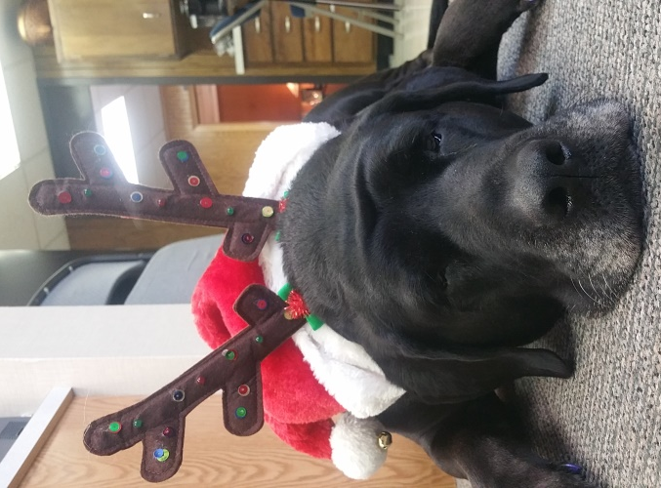
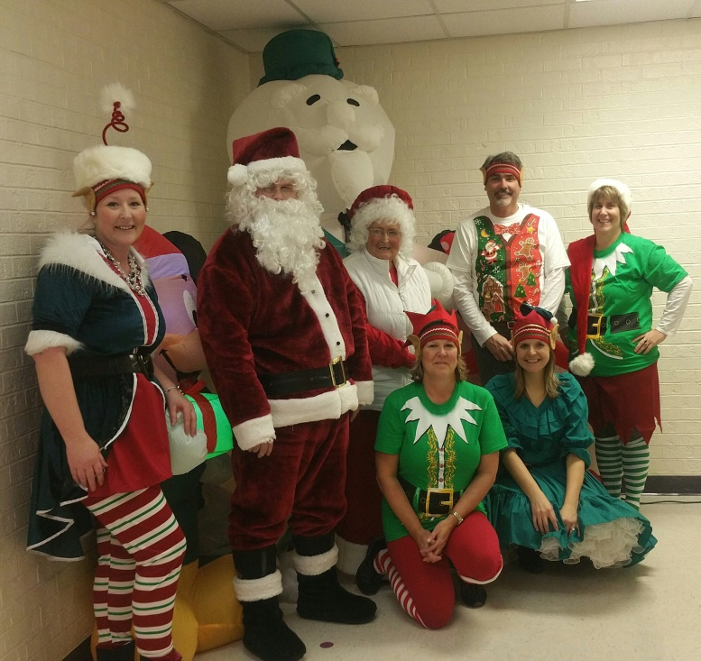
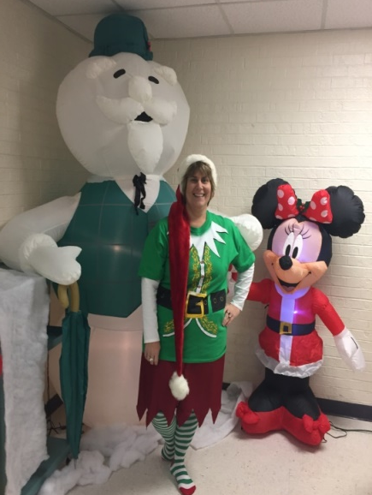
100% November: Santa, Mrs. Claus, and Elves

Slide 9
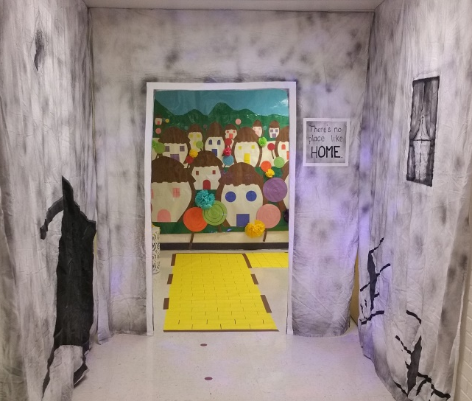
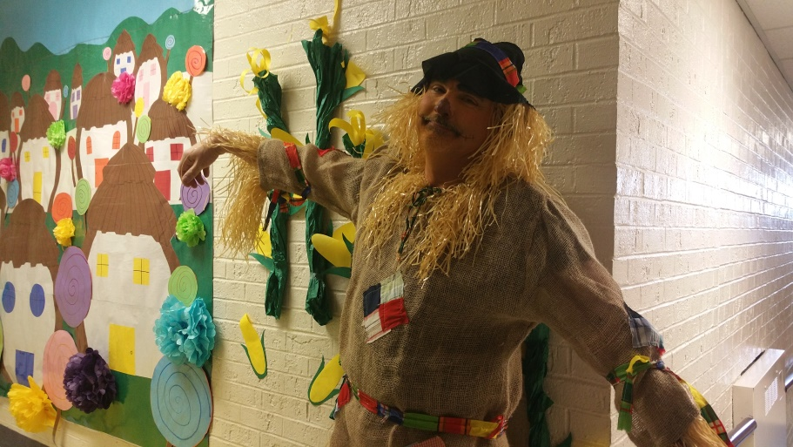
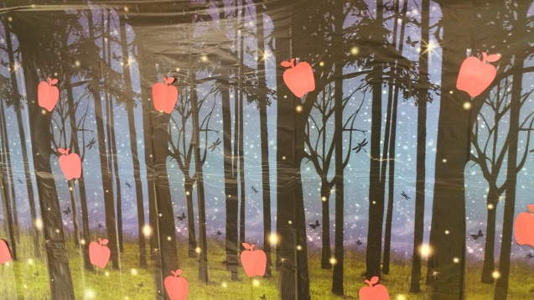
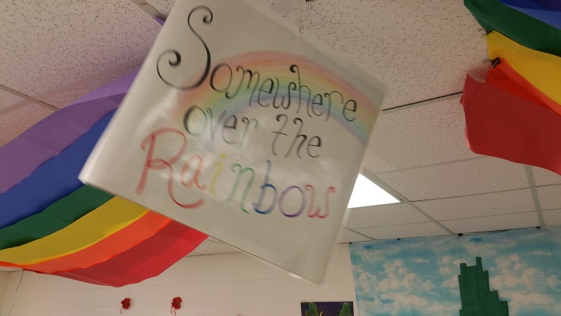
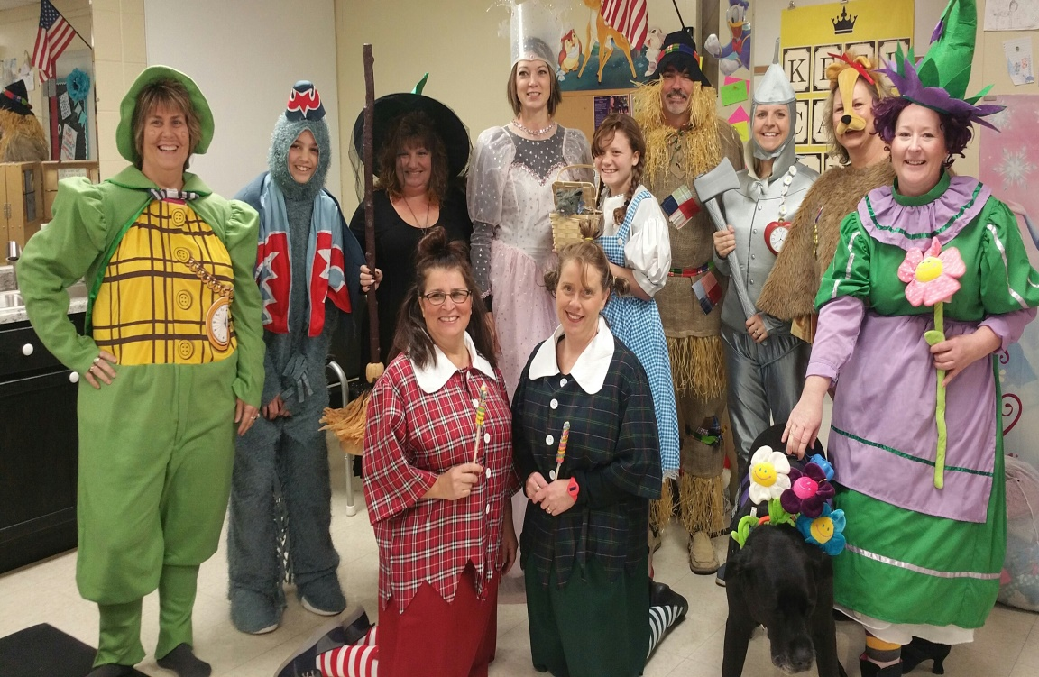
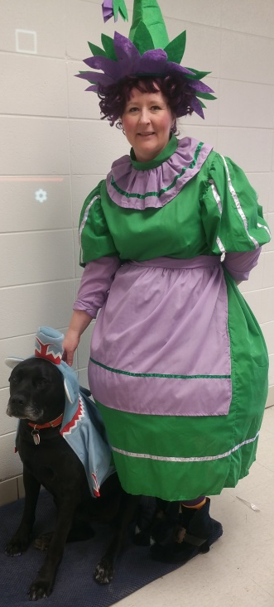
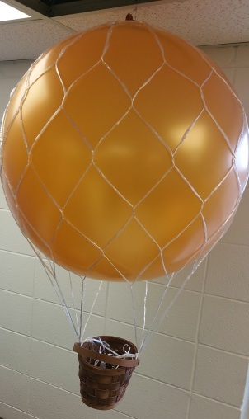
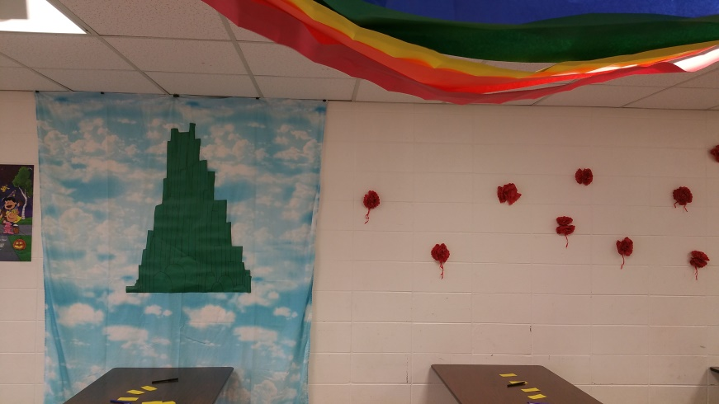
100% December: Wizard of Oz

Slide 10
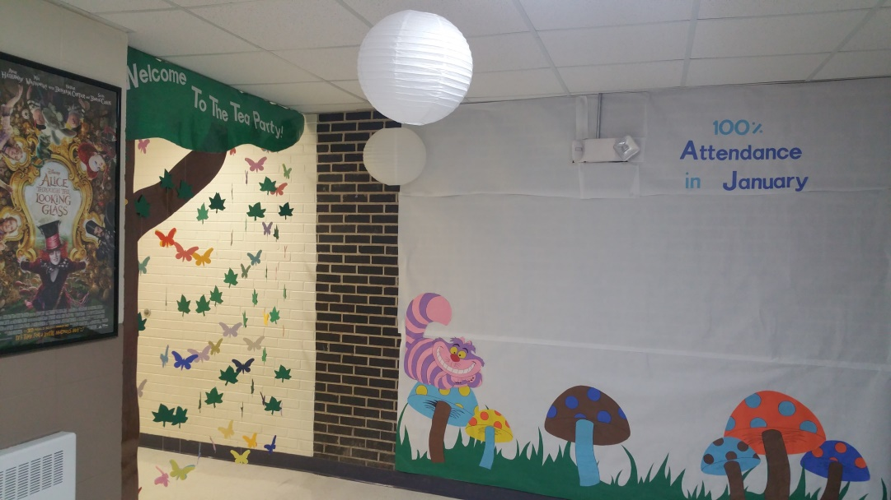
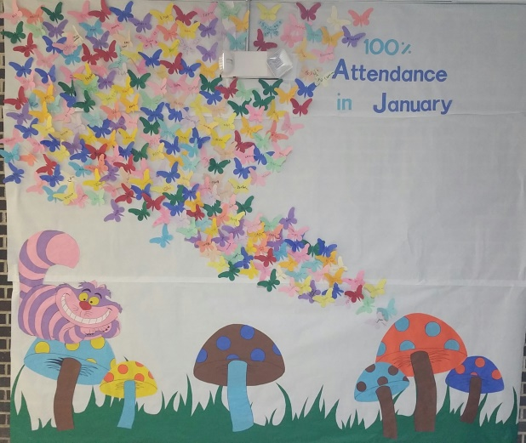
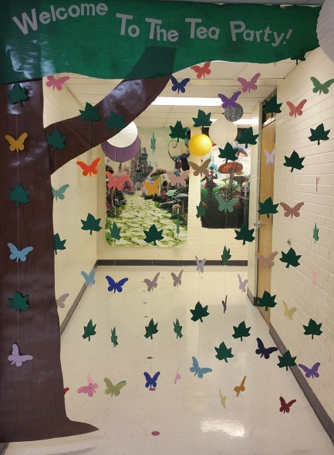
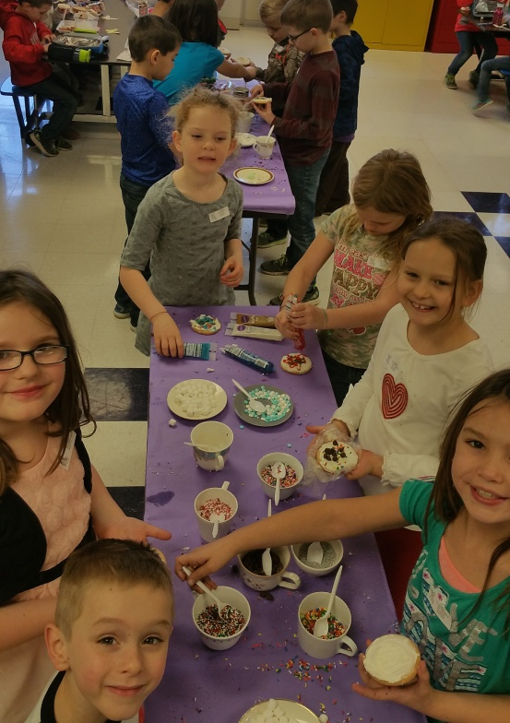
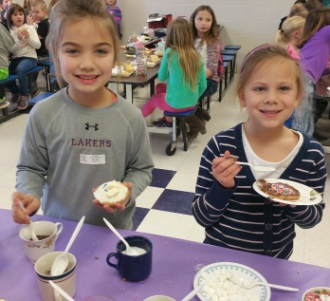
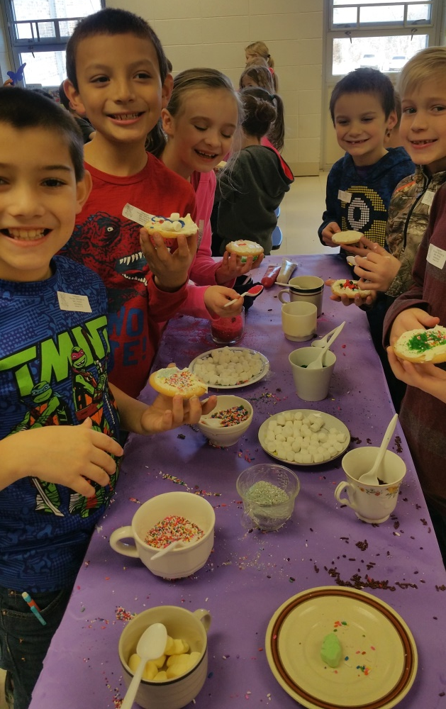
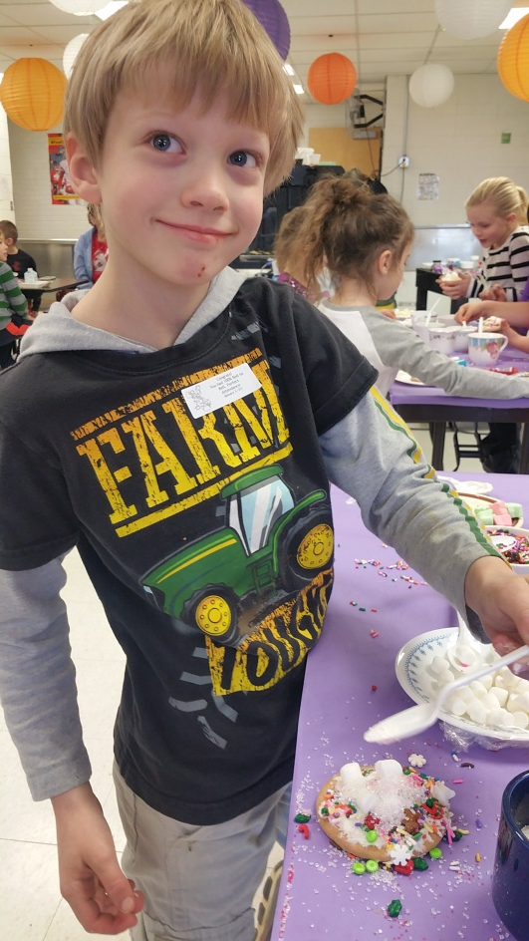
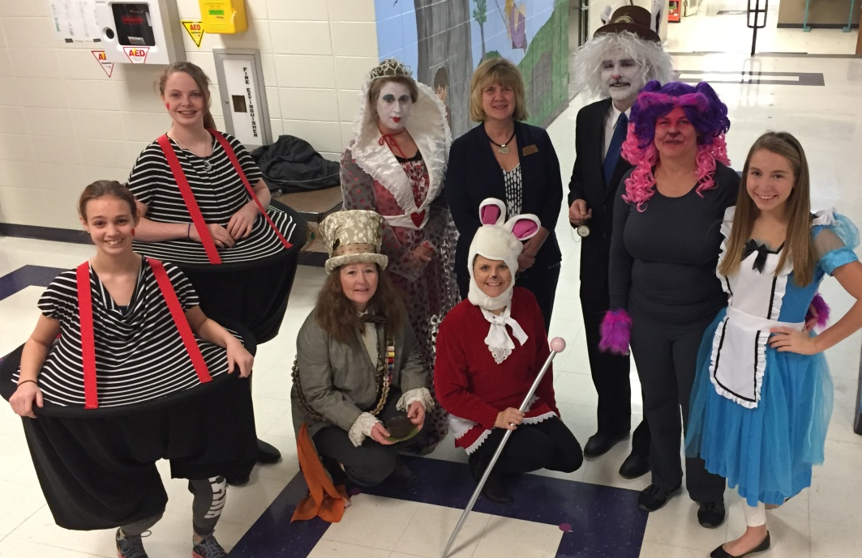
100% January: Mad Hatter Tea Party

Slide 11
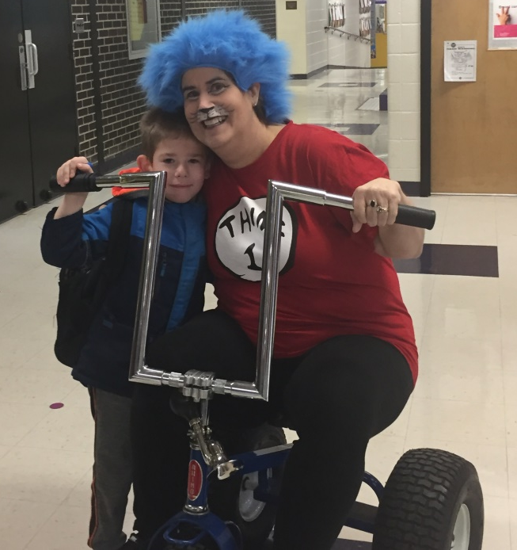
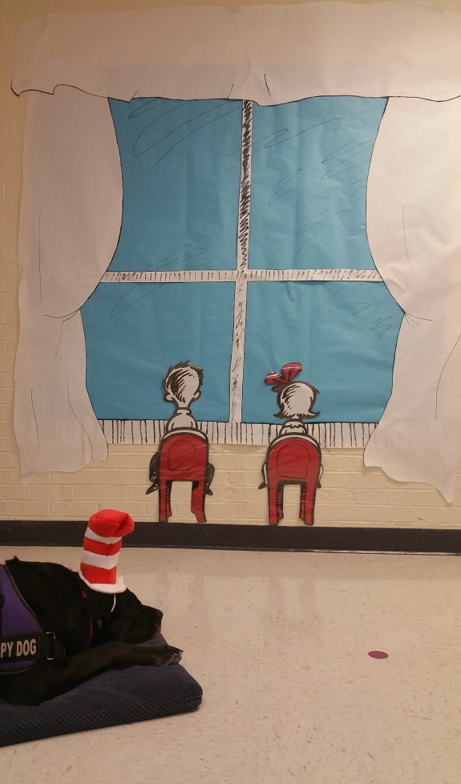
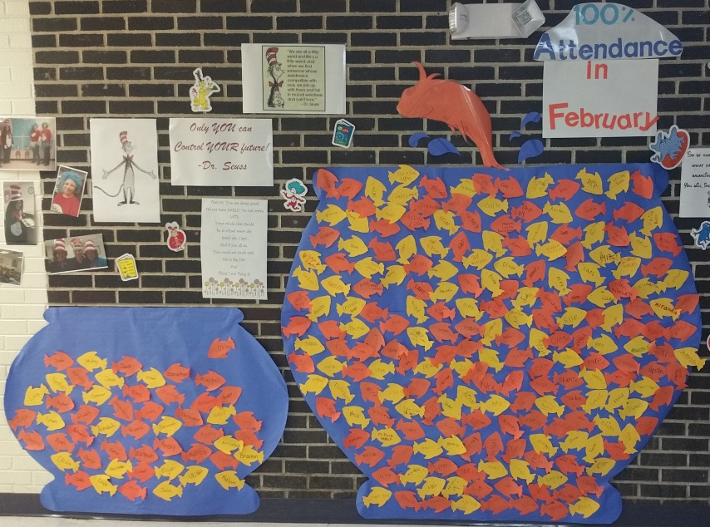
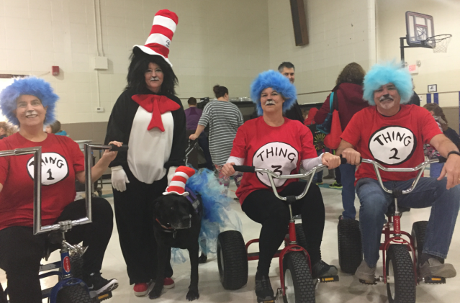
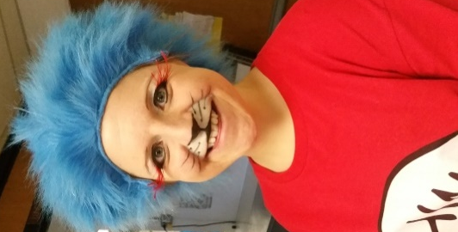
100% February: Cat in the Hat

Slide 12
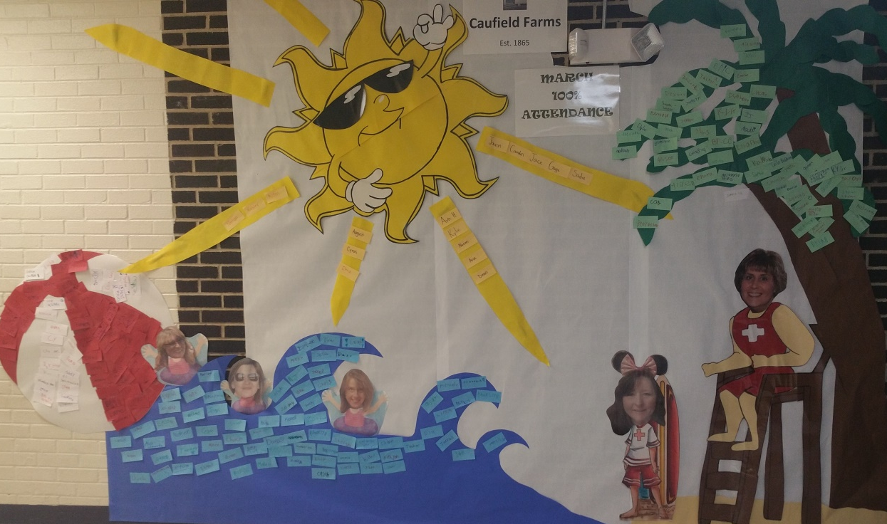
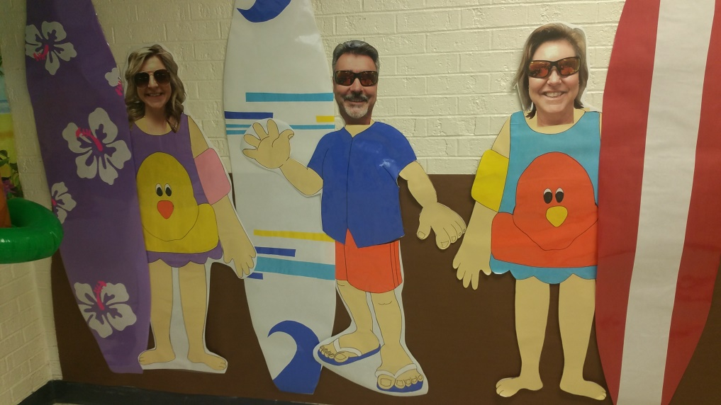
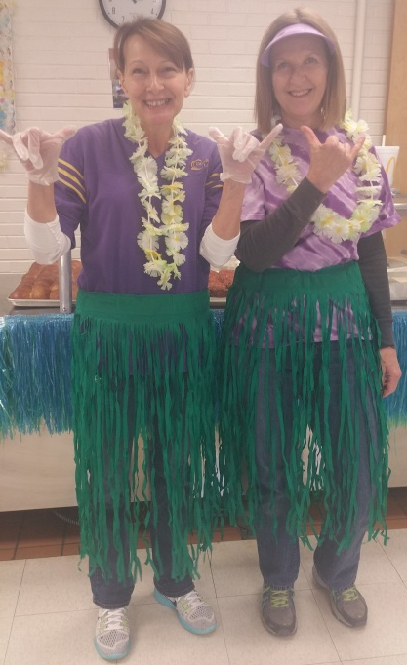
100% March: Luau

Slide 13
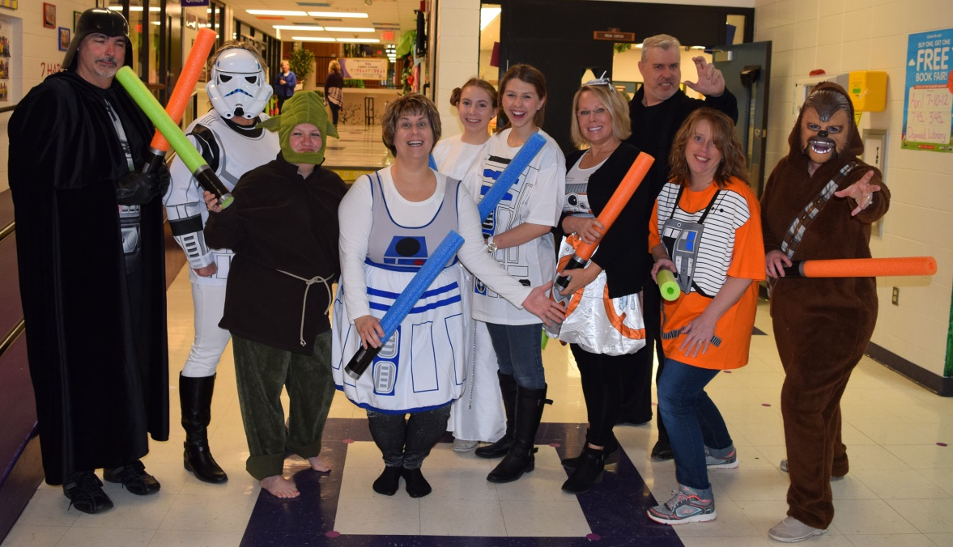
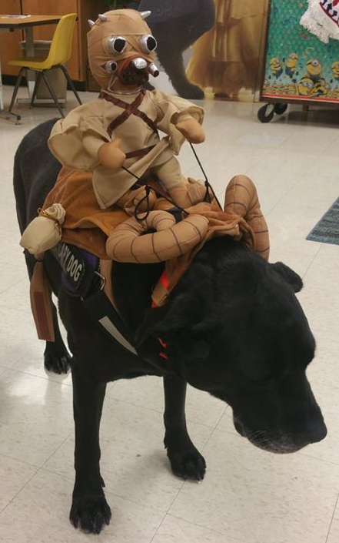
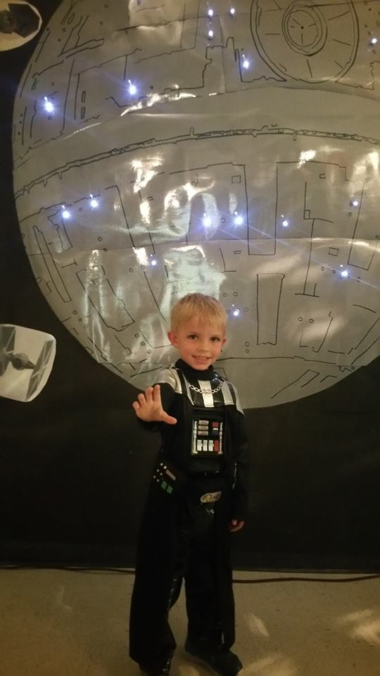
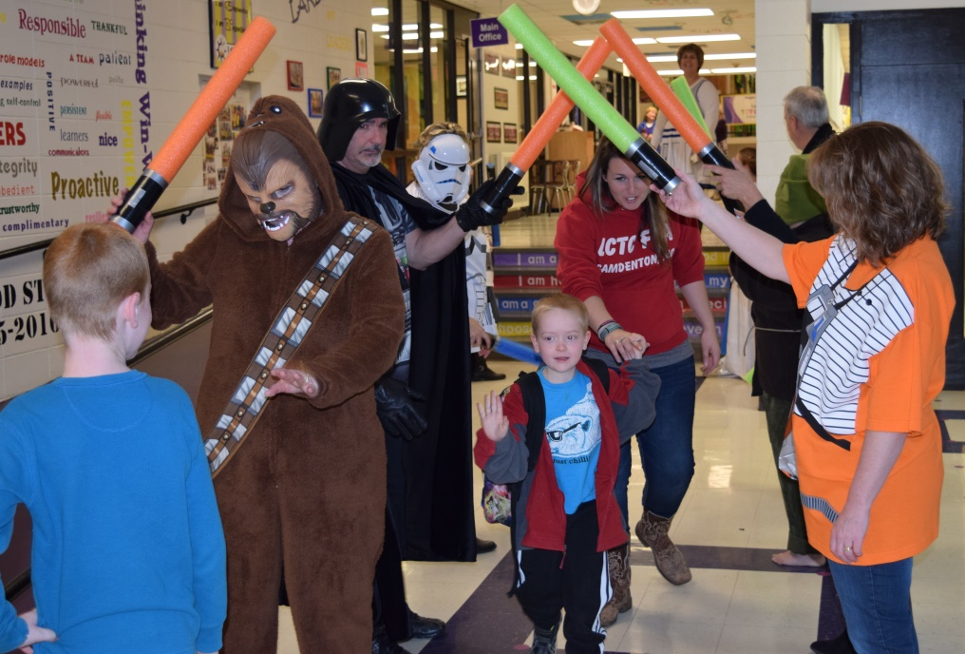
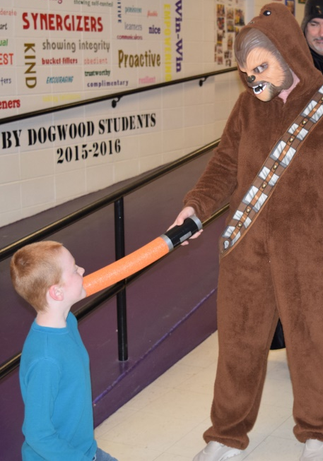
100% April

Slide 14
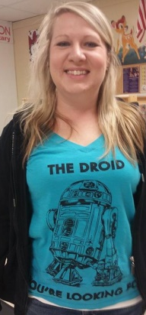

Slide 15
100% May: Last day of school: Super Hero Day!

Slide 17
Molly, DE Certified Therapy Dog

Slide 20
Dogwood Lunch Ladies Are SUPER HEROES!

Slide 21
Dogwood Custodians Are SUPER HEROES!

Slide 22
Homecoming Parade: 2016

Slide 23
St. Patrick’s Day

Slide 24
Easter

Slide 25
Cosmic Kids YOGA

Slide 26
Sleeping Bag Drive
Dr. Ed and Angie Barns, along with Kiwanis of Ozark and Share the Harvest, contributed 100 sleeping bags from MC Sports in Springfield, MO, to the Camdenton School District to assist those students and families who need a little extra warmth this winter.
2015/16 over 350 sleeping bags were distributed.
2016/17 over 100 more…

Slide 27
Before
Before
After
After

Slide 28
Before
Before
After
Before
After
After

Slide 29
After
Before
108 Hair cuts at DE
Before
After

Slide 31
2017 Grad Walk

Slide 33
Dogwood Elementary is some of our student’s NEVERLAND. It is their escape from the hard reality that some of them face. The reality of hurt, hunger, homelessness, abuse, & neglect.

Slide 34
That is why: IN DOGWOOD ELEMENTARY We Let It Go Because Hakuna Matata and the bear necessities Will always be our guide To Infinity and Beyond ! All it takes is faith, trust, and a little bit of pixie dust WHILE WE JUST KEEP SWIMMING and whistle while we work ! And we know that LIFE IS BETTER UNDER THE SEA Because in this school, we do Happily Ever After! May The Force Be With You!

Slide 35
Social Work Service Stats:
Total Number of Social Work Service Referrals: 594

Slide 36
A special thanks to
Dr. Dill, Dr. Neal, Dr. Hadfield,
& Camdenton R-III School Board
For their vision of
Excellence to serve
EVERY STUDENT!

